Slide 1
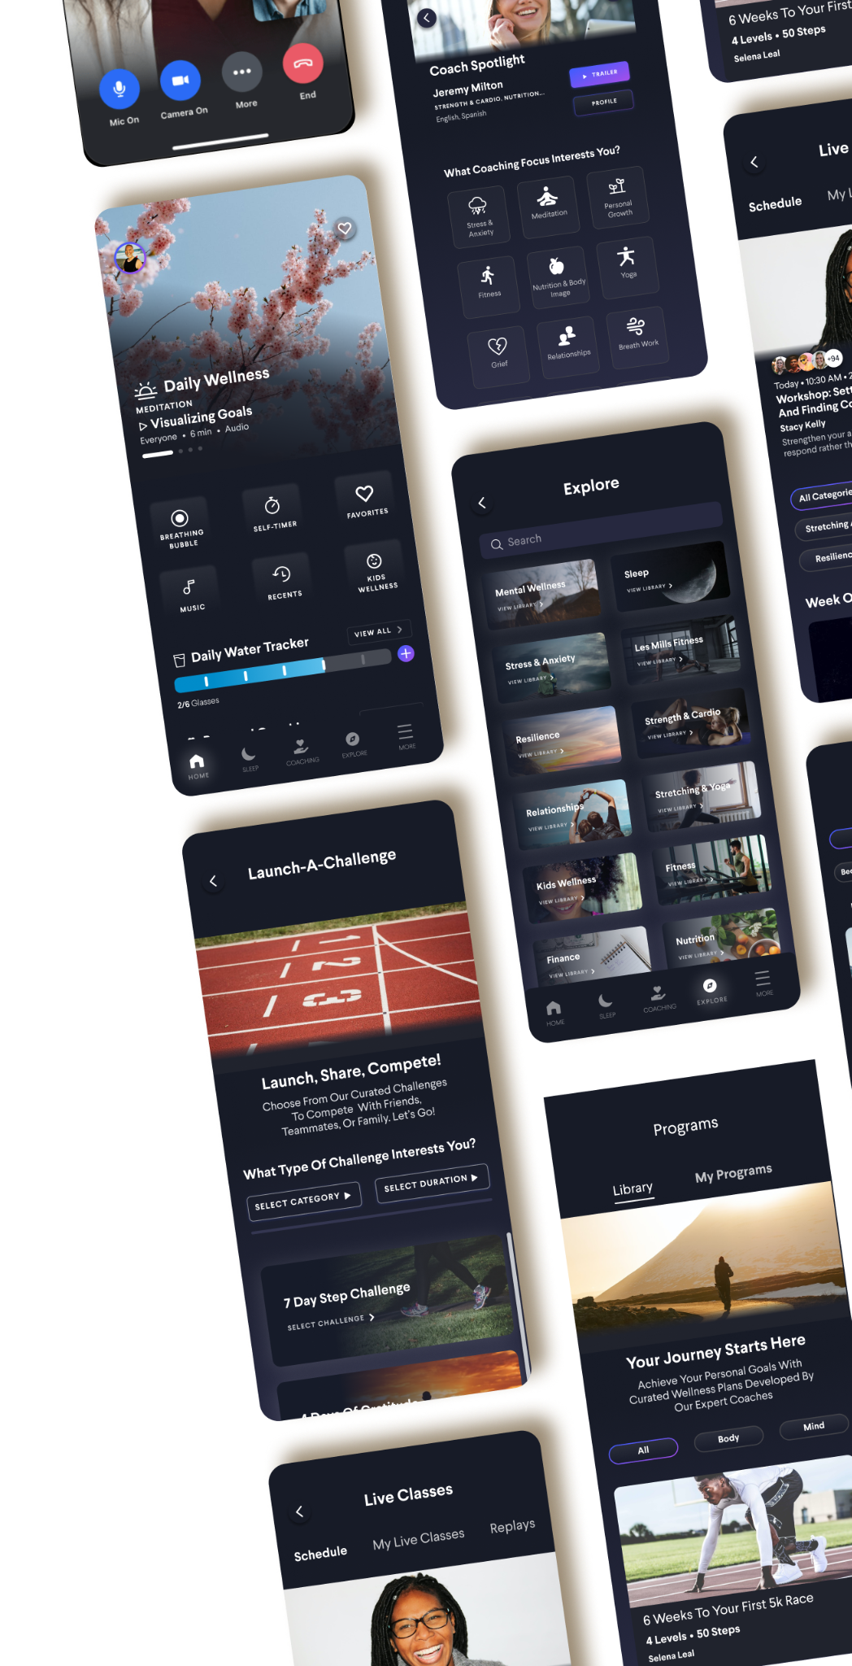


DUO
SSO Setup Guide
Notes:
TITLE PAGE_ 3

Slide 2
DUO SSO with Wellness Coach
Wellness Coach supports Single Sign On (SSO) (DUO) to access the app
with one set of login credentials
Single Sign On
DUO Single Sign On (SSO) Solution provides easy and seamless access to Wellness Coach with one set of credentials, from any type of device or application whether they are in the cloud or on premise
Fraud Prevention
DUO helps to prevent fraud with its dynamic risk engine in conjunction with enterprise specific security policy. It supports a combination of the Device ID, Location, and Time of access as multi-factor authentication that can help to detect and block fraud in real-time, without any interaction with the employee
Employee Access Management
With SSO through DUO, employee access to Wellness Coach will be managed automatically. Any new hires will automatically get access to Wellness Coach on their date of hire and any terminated employees access will be revoked on their termination date

Slide 3
DUO SCIM with Wellness Coach
Wellness Coach supports Active Directory sync through SCIM
SCIM: System for Cross-domain Identity Management
Benefits of SCIM
Employee Access Management - the automation of enabling and disabling employees’ access to Wellness Coach
Once an employee is added to DUO, their access to Wellness Coach is established, no additional steps are required by IT or the HR department

Slide 4
DUO SSO with Wellness Coach
Technical Steps Needed to Launch SSO for with Wellness Coach

Slide 5
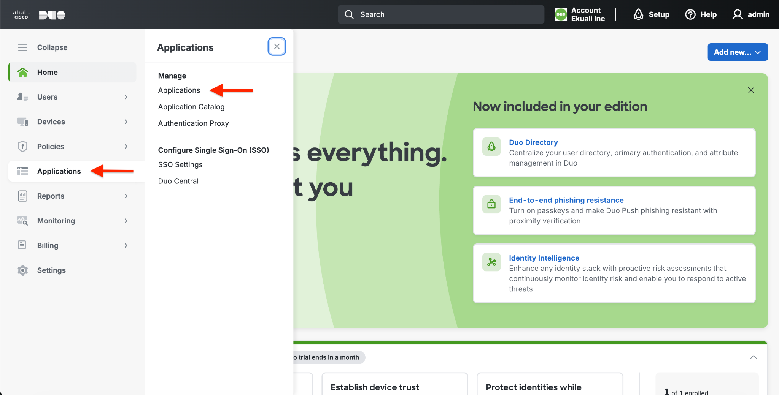
DUO SSO with Wellness Coach
Go to DUO Admin Console
Click on “Applications” on left hand side menu

Slide 6
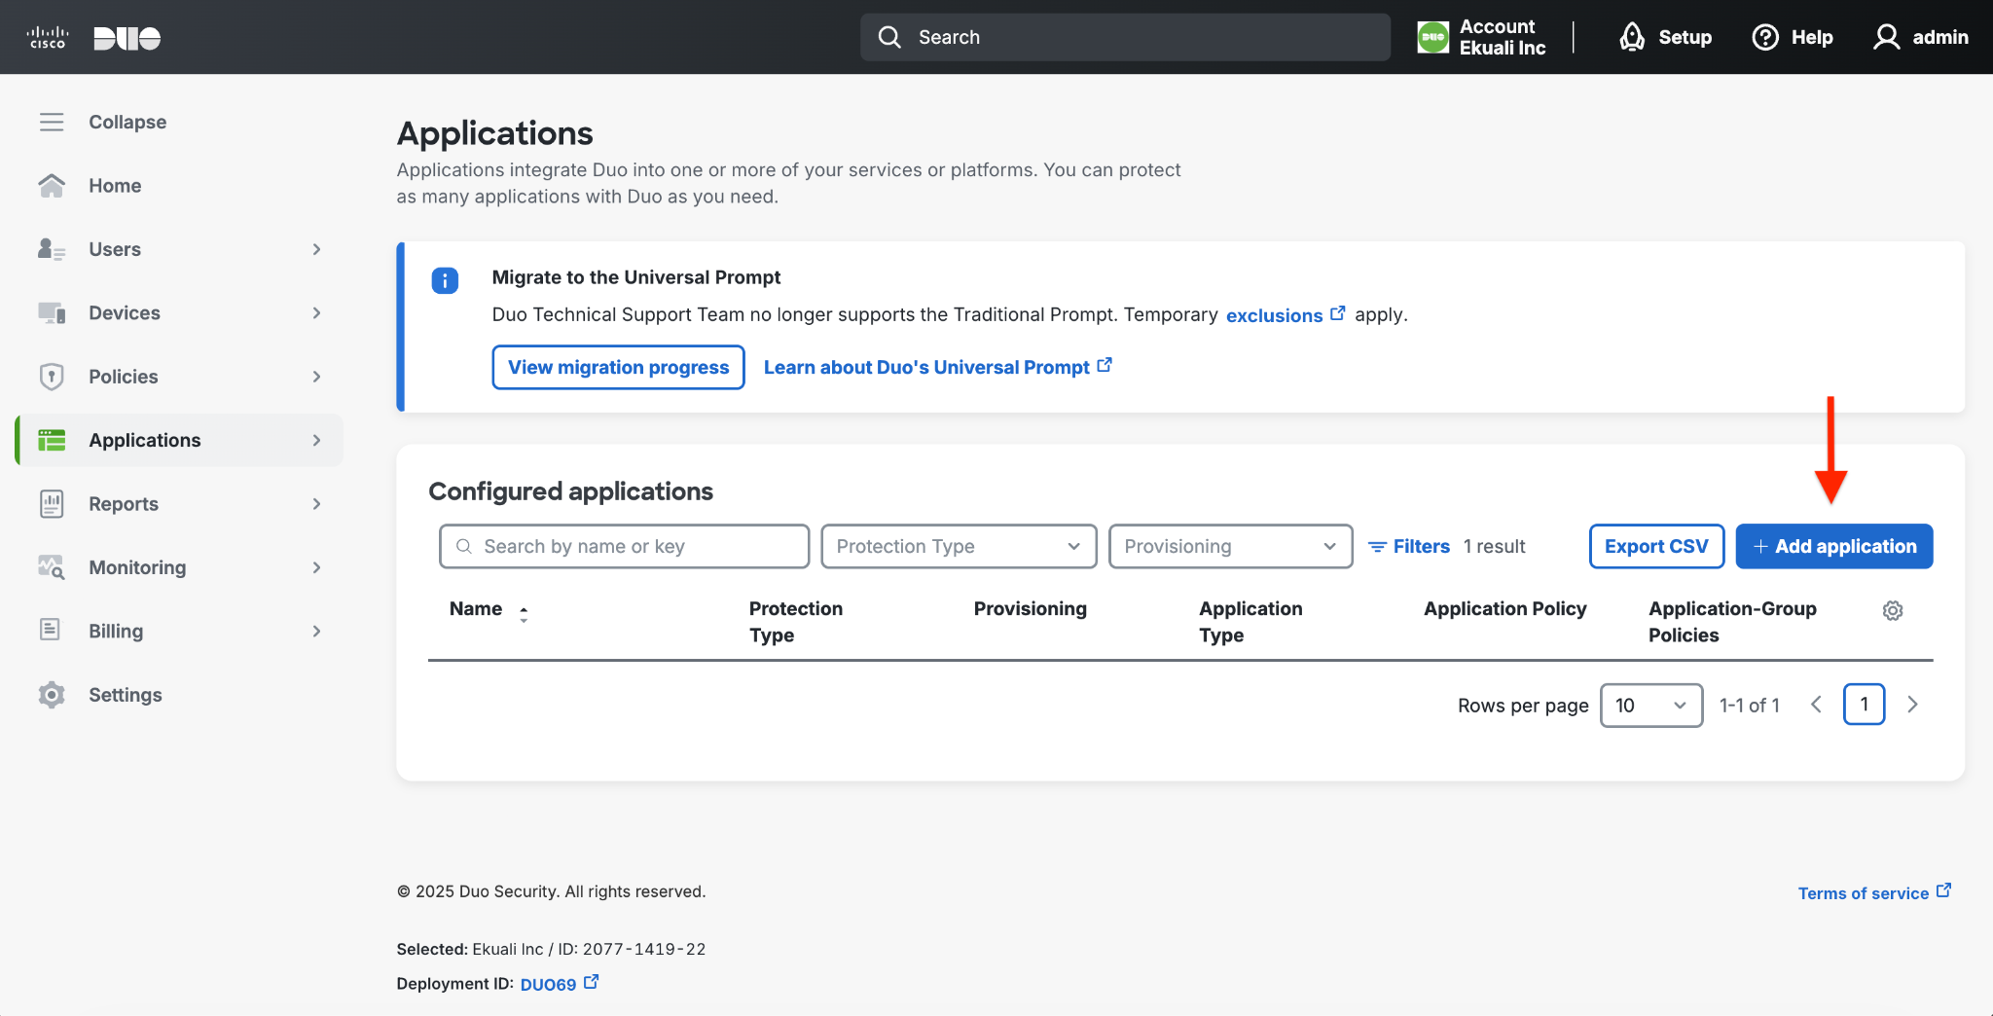
DUO SSO with Wellness Coach
Click “Add application”

Slide 7
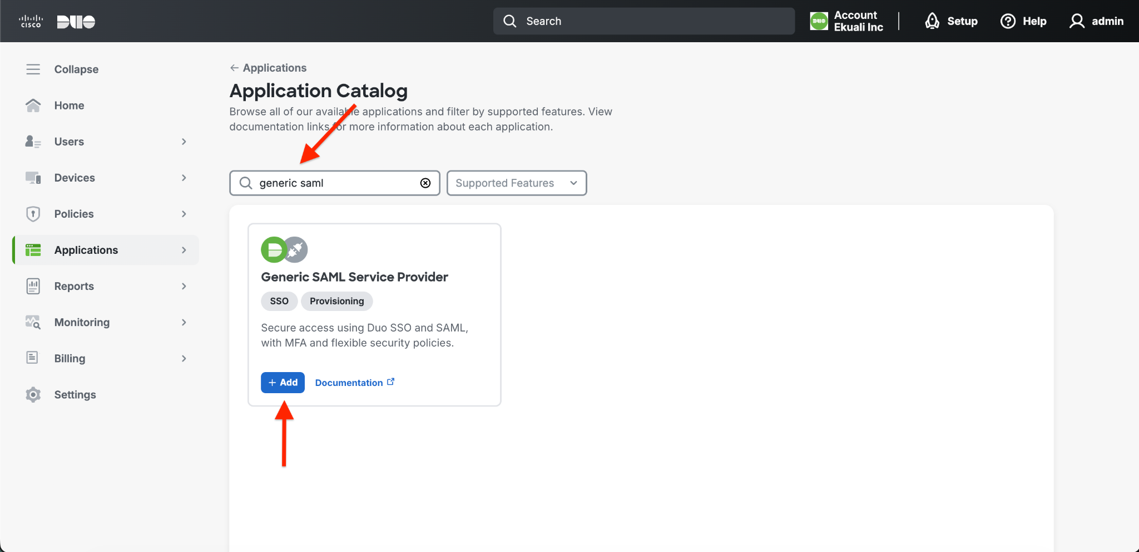
DUO SSO with Wellness Coach
Search “generic saml” Click on “+Add”

Slide 8
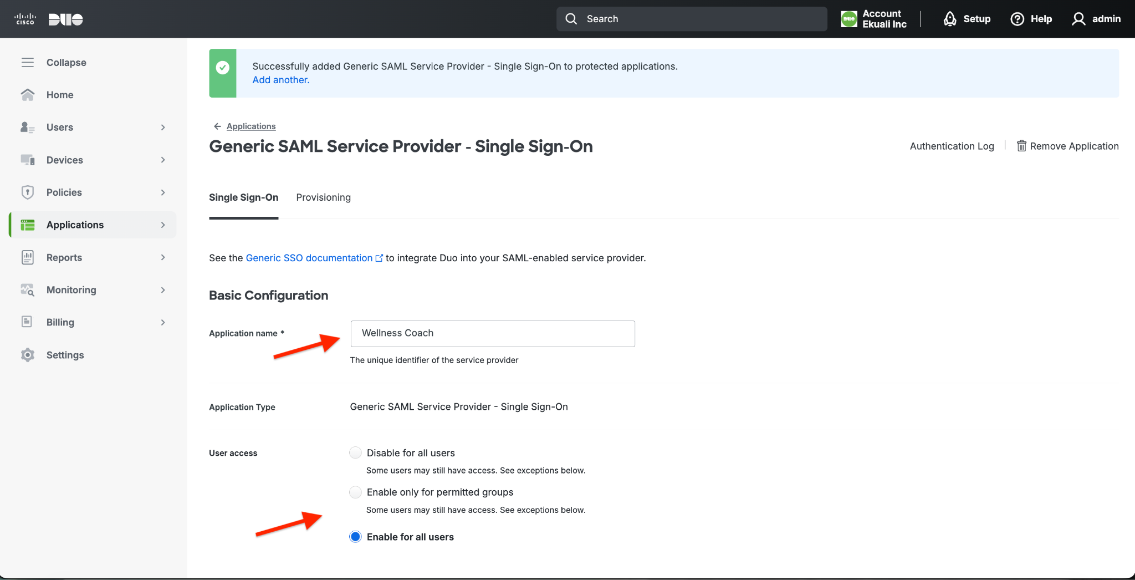
DUO SSO with Wellness Coach
Enter Application name “Wellness Coach”
Choose User access
(“Enable for all users” is recommended)

Slide 9
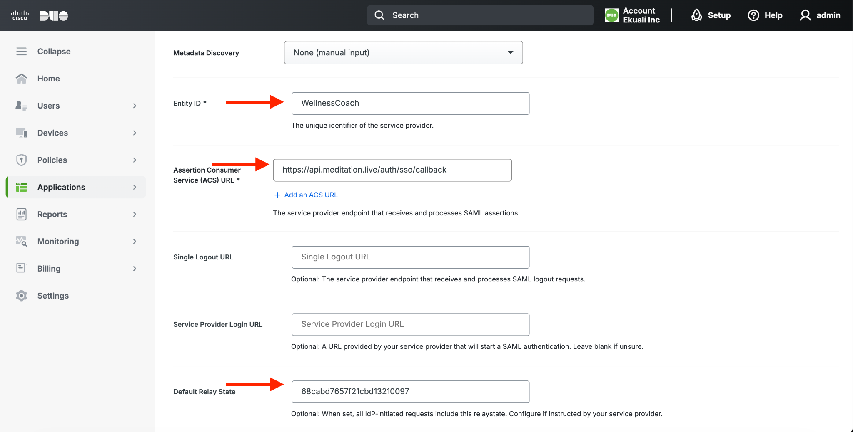
DUO SSO with Wellness Coach
Type Entity ID -> “WellnessCoach”
Type “Assertion Consumer Service (ACS) URL” -> “https://api.meditation.live/auth/sso/callback”
Default Relay State (Mandatory)
Key will be supplied by Wellness Coach: Please contact your CS rep or CustomerSuccess@wellnesscoach.live for the key

Slide 10
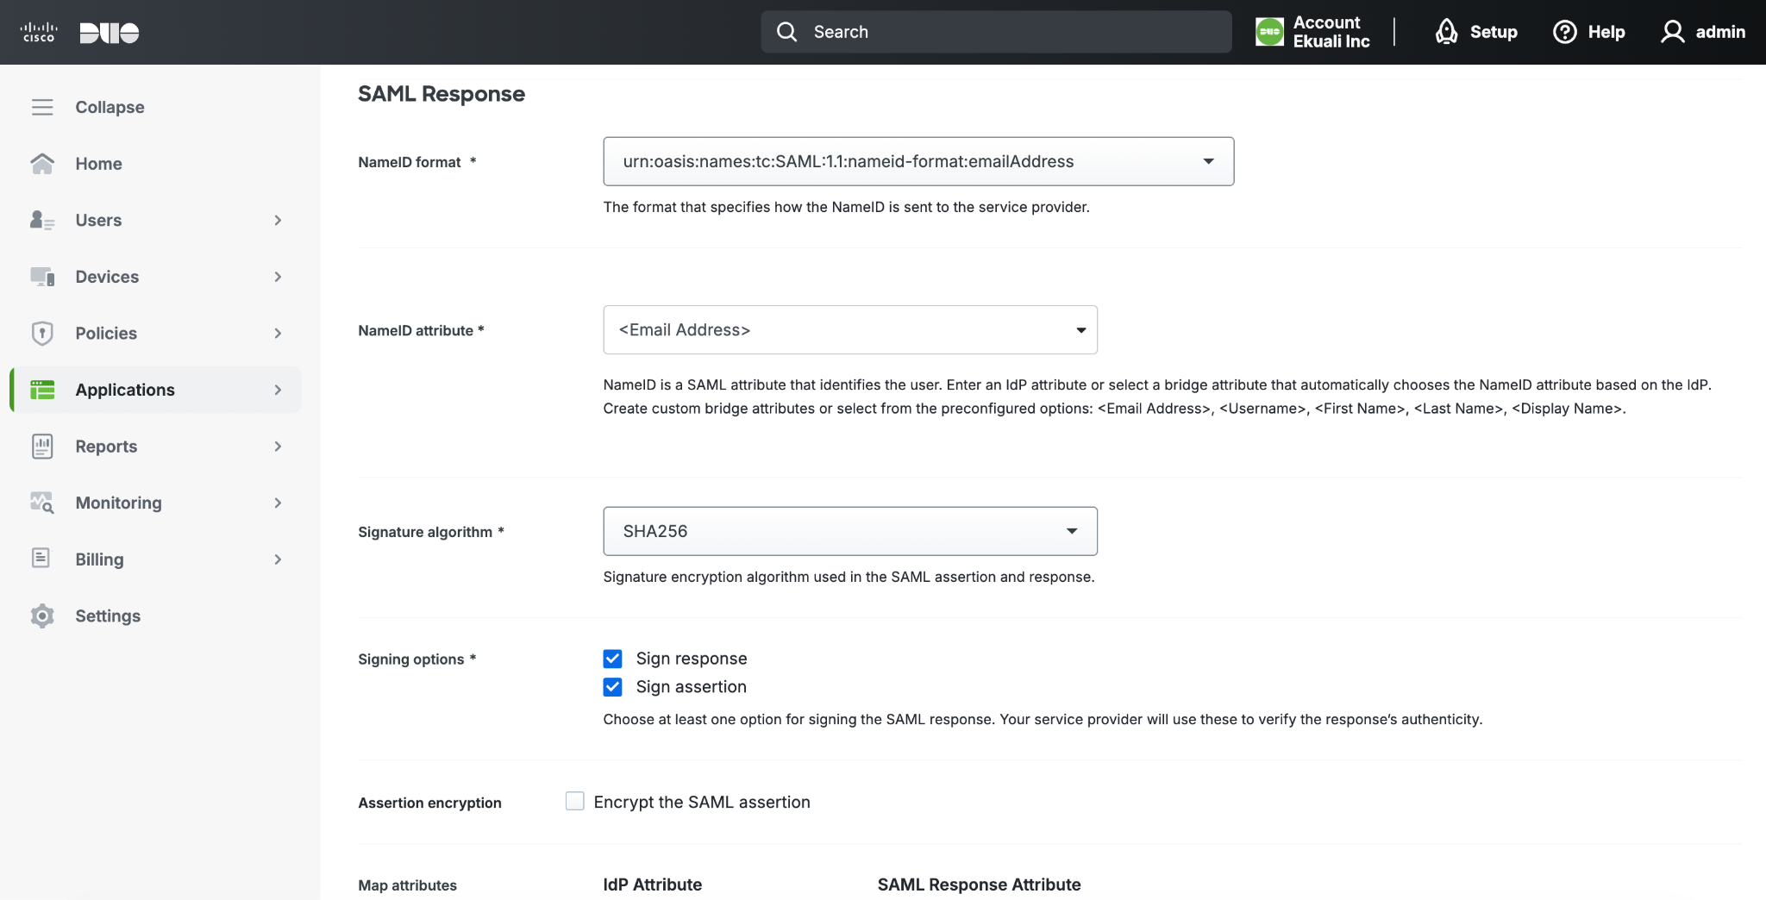
DUO SSO with Wellness Coach
Scroll page to “SAML Response” section
Set the “NameID format” shown in the screen
“NameID attribute” should be “Email Address”

Slide 11
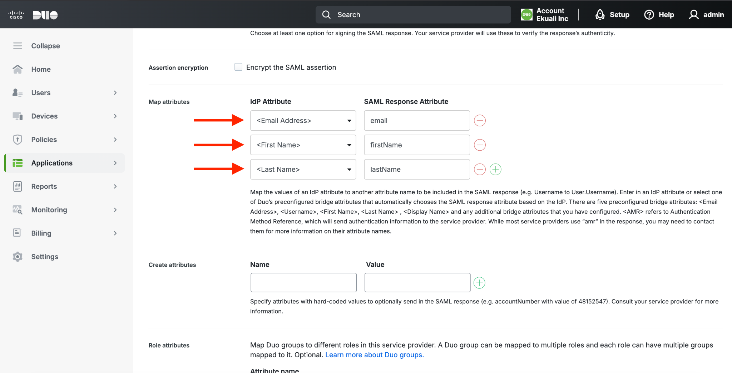
DUO SSO with Wellness Coach
Scroll page to “Map Attributes” section
Create the attributes shown in the screen
“email”
“firstName”
“lastName”
Use the green + icon to add more

Slide 12
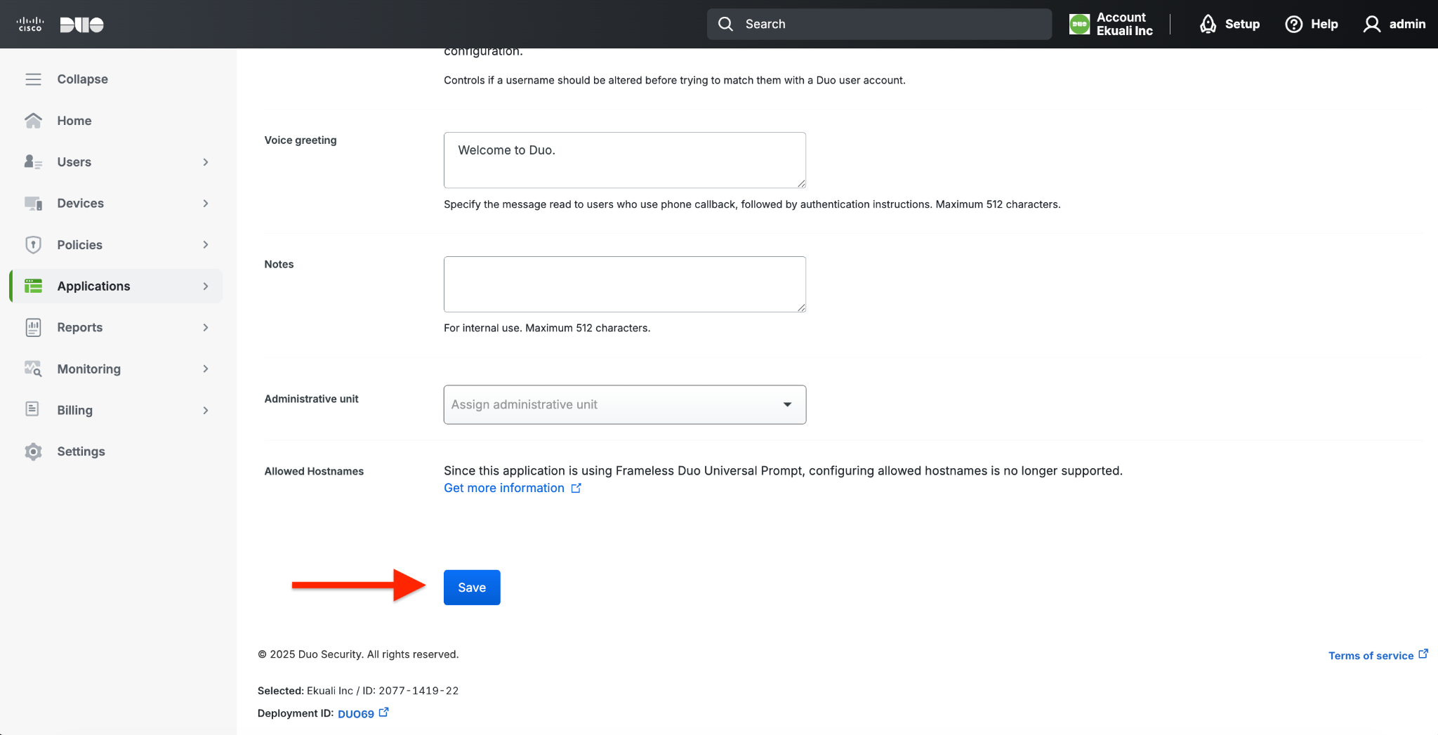
DUO SSO with Wellness Coach
Scroll below and Click “Save”

Slide 13
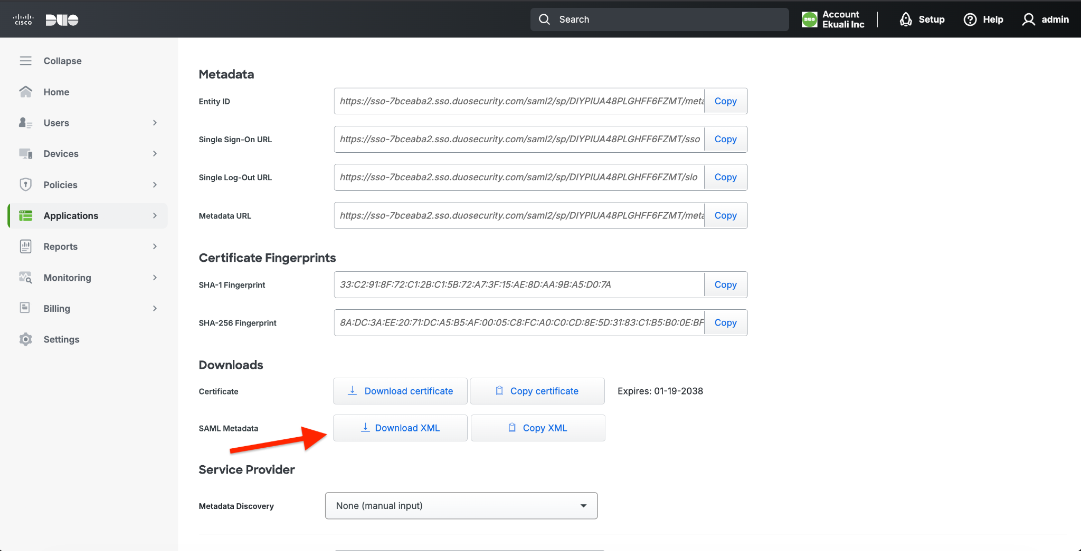
DUO SSO with Wellness Coach
Scroll up to “Metadata” section and download SAML Metadata from “Download XML” button and share to Wellness Coach Team

Slide 14
DUO SCIM with Wellness Coach
Technical Steps Needed to Launch SCIM Provisioning (DUO) with Wellness Coach

Slide 15
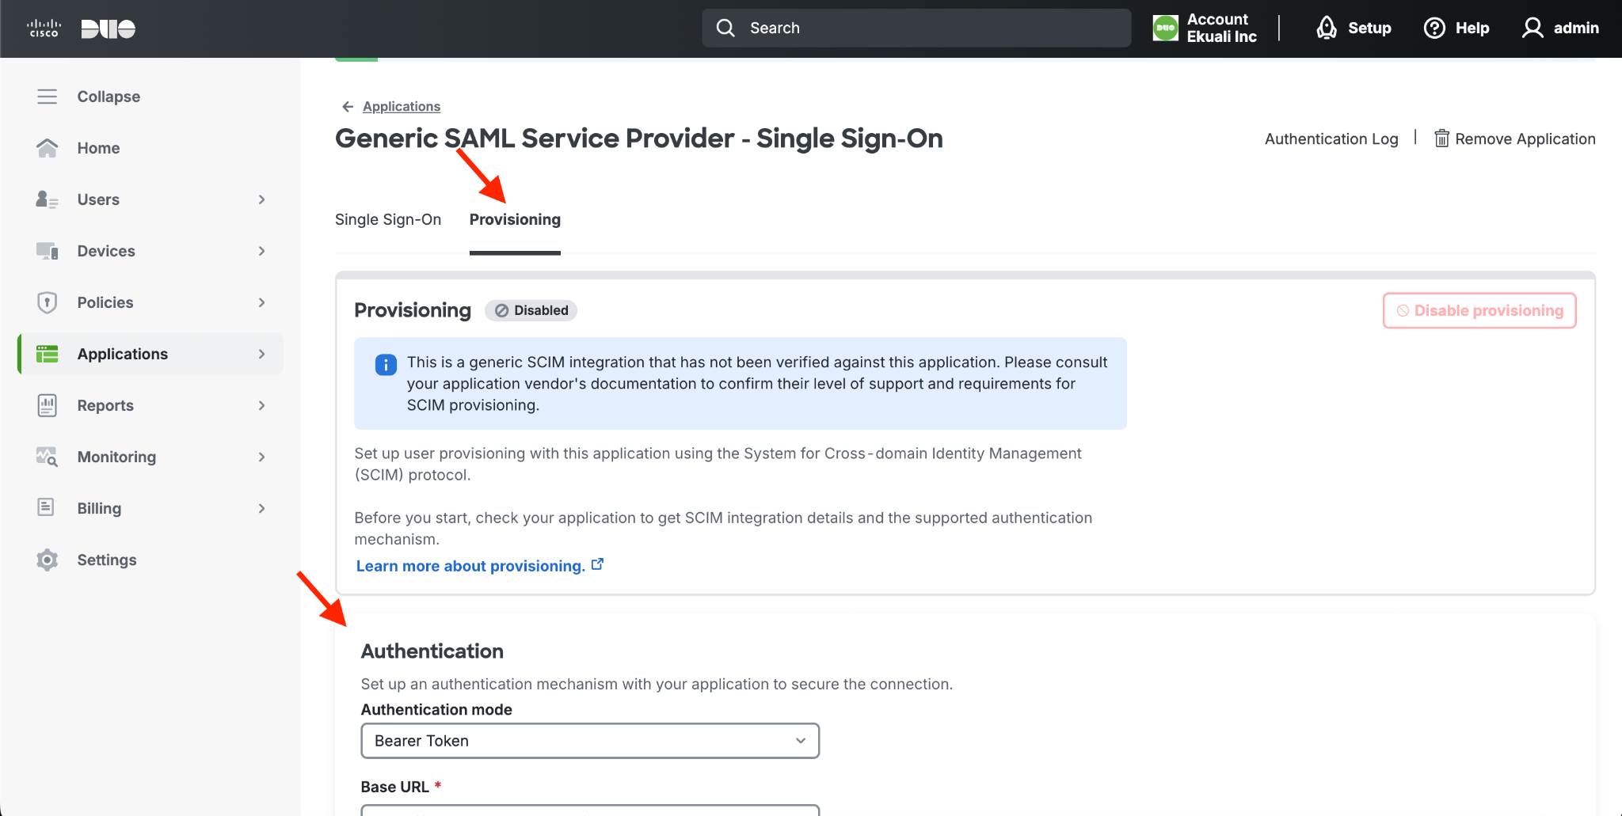
DUO SCIM with Wellness Coach
Go to “Provisioning ” tab
Scroll to “Authentication”

Slide 16
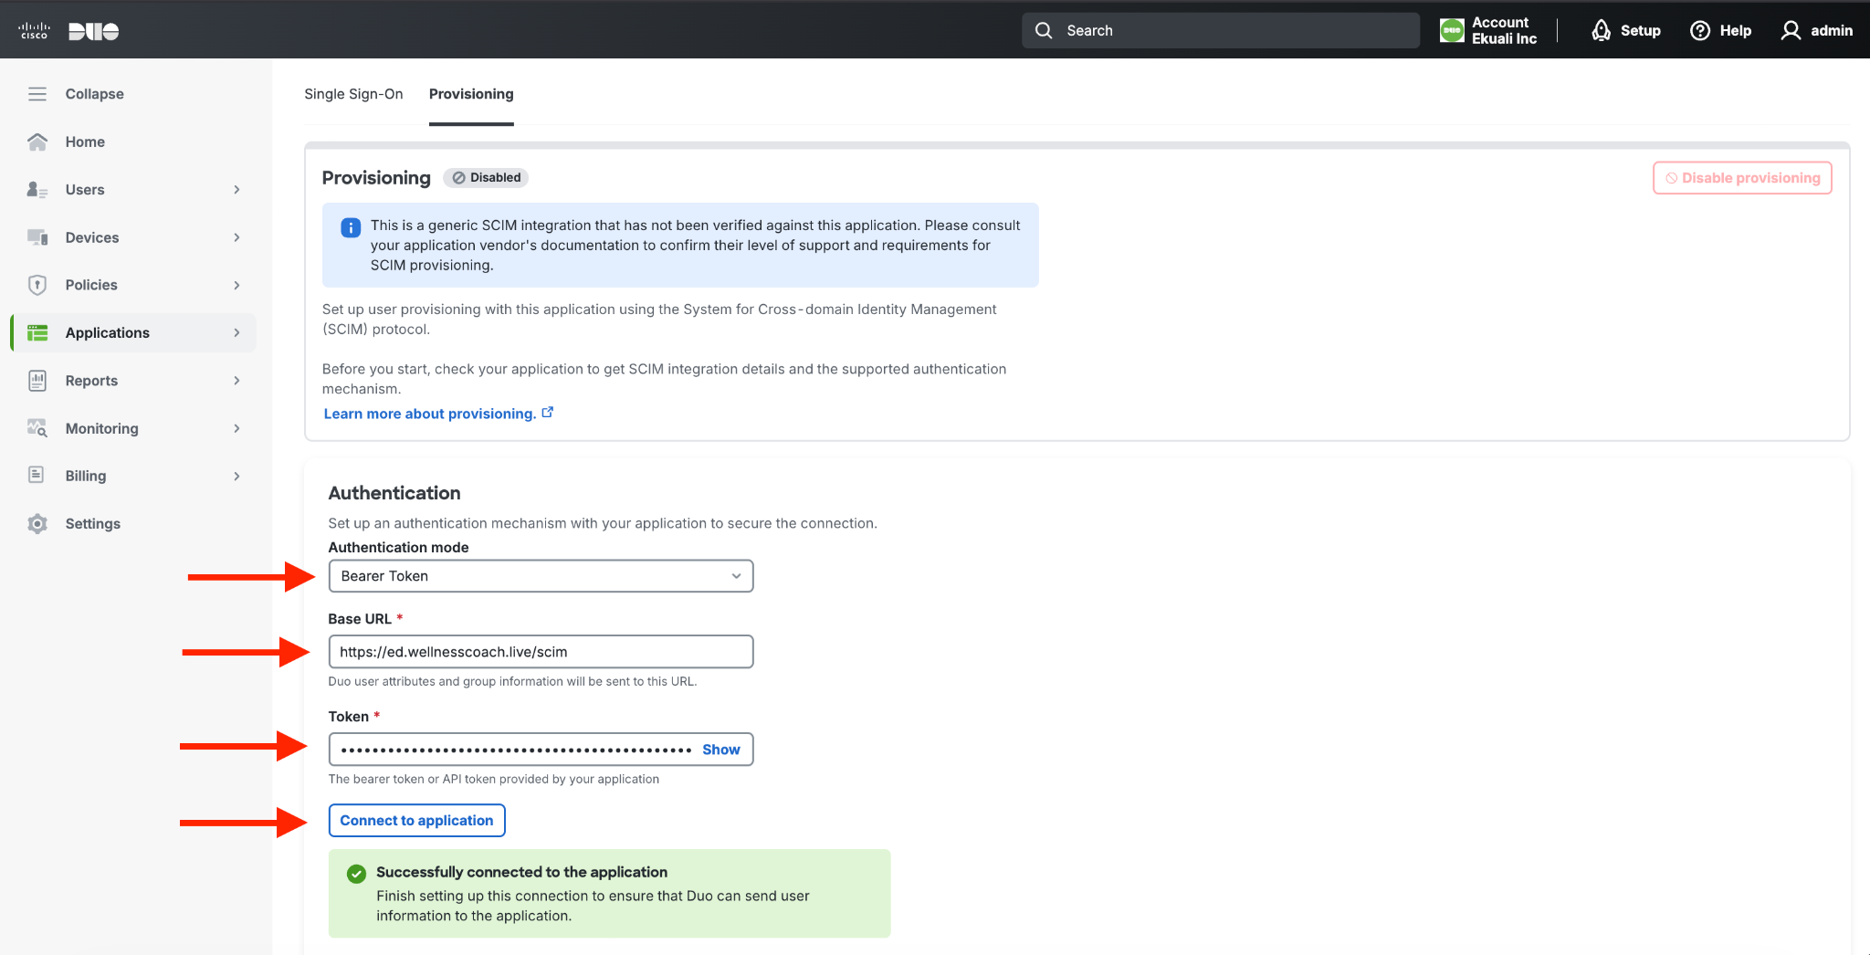
DUO SCIM with Wellness Coach
Select Authentication mode as “Bearer Token”
Add Base URL as https://ed.wellnesscoach.live/scim
Add Token. Please send an email to Wellness Coach for the token
Test by clicking “Connect to application

Slide 17
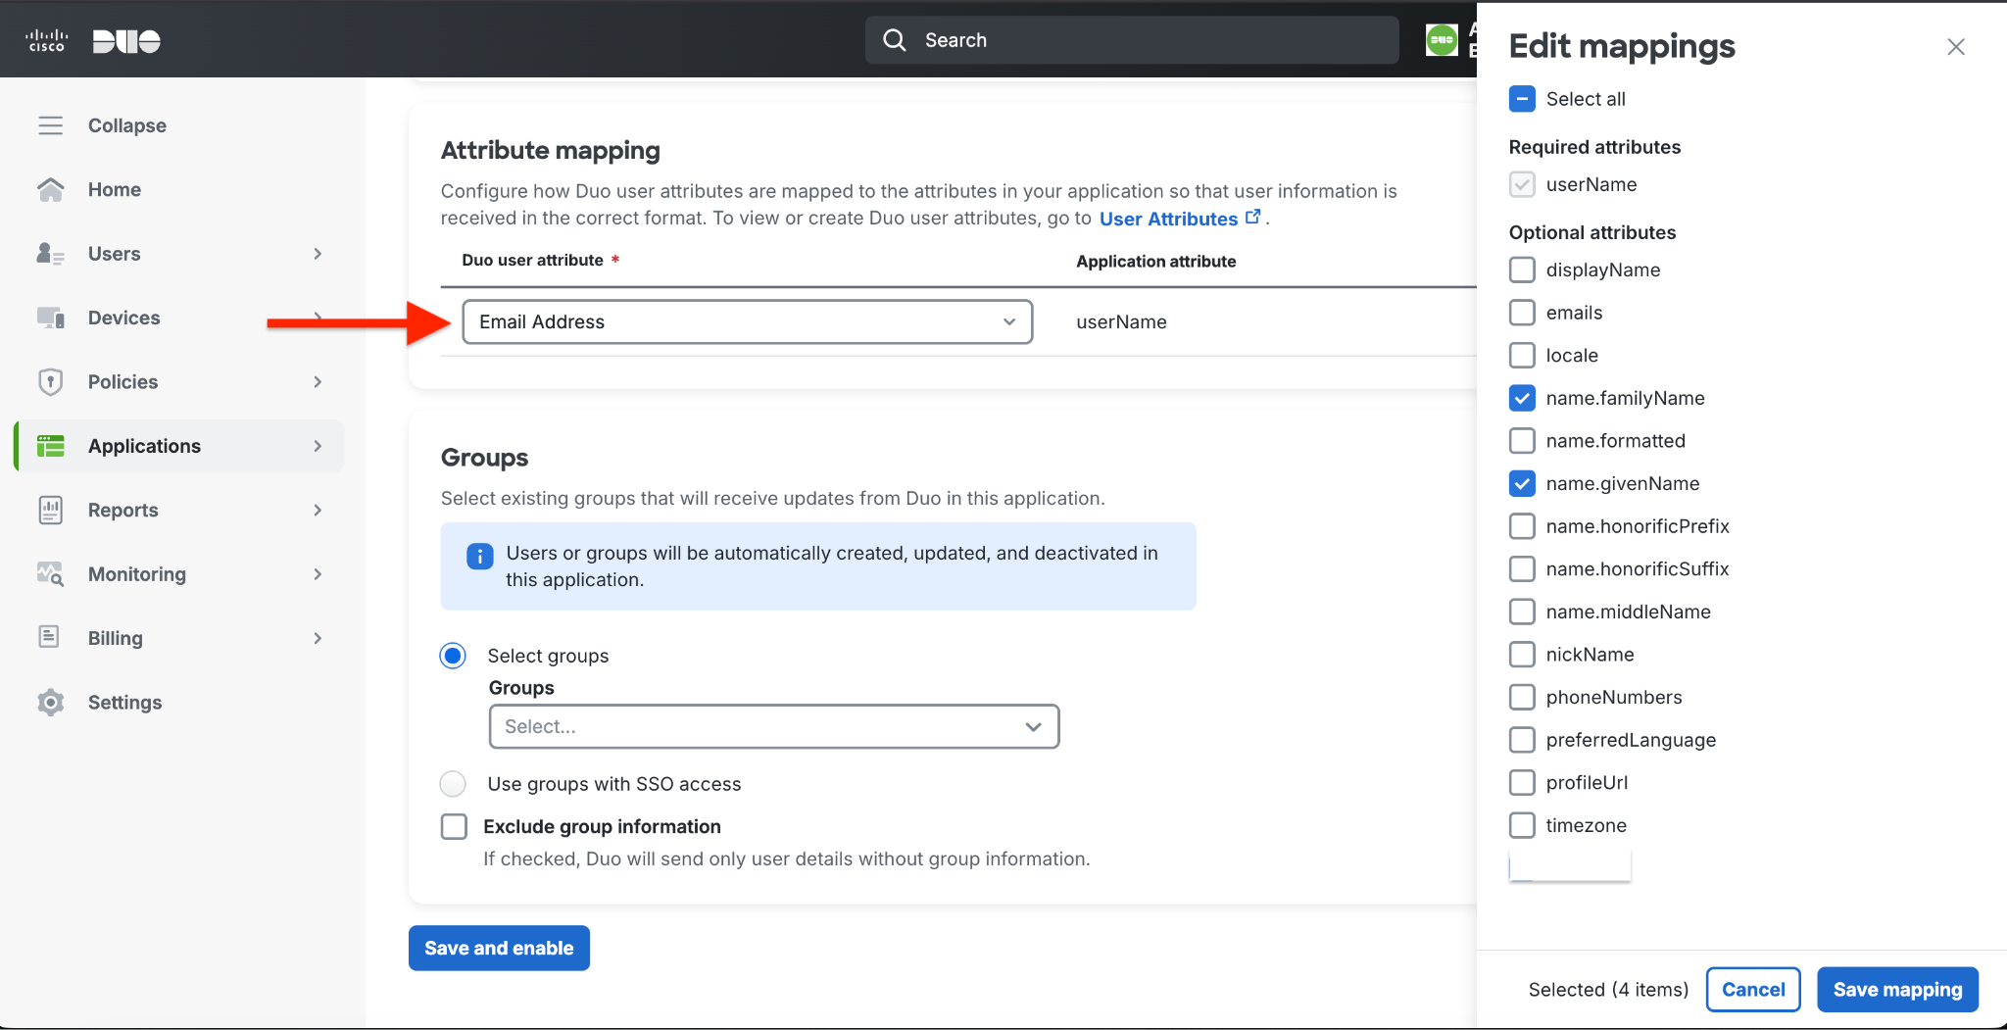
DUO SCIM with Wellness Coach
Scroll to Attribute Mapping
Select Email Address for userName
Click on Edit Mappings and select name.familyName and name.givenName
Click “Save Mapping”

Slide 18
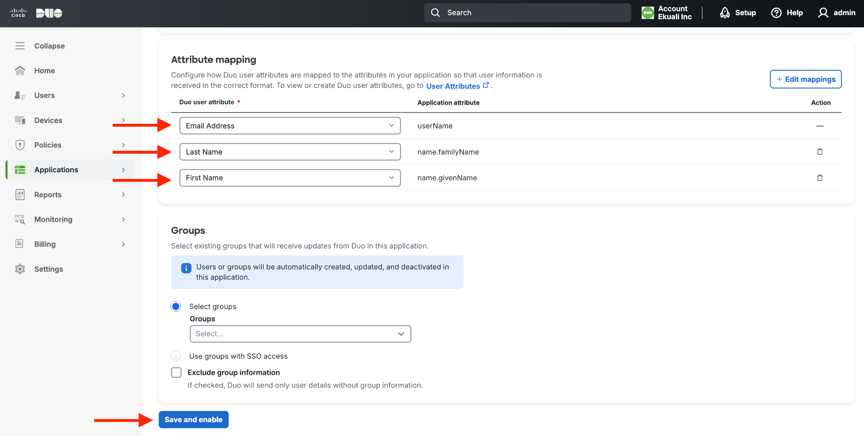
DUO SCIM with Wellness Coach
Select “First Name” for givenName
Select “Last Name” for familyName
Click “Save and enable”

