Slide 1


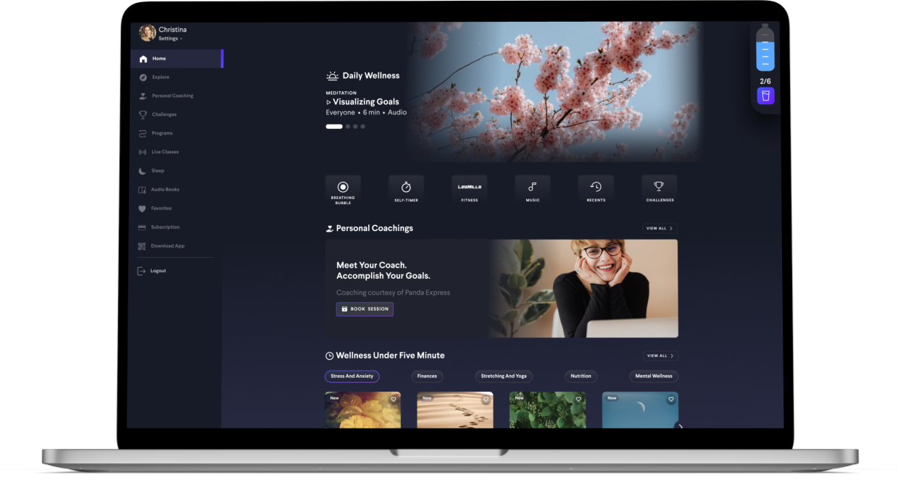
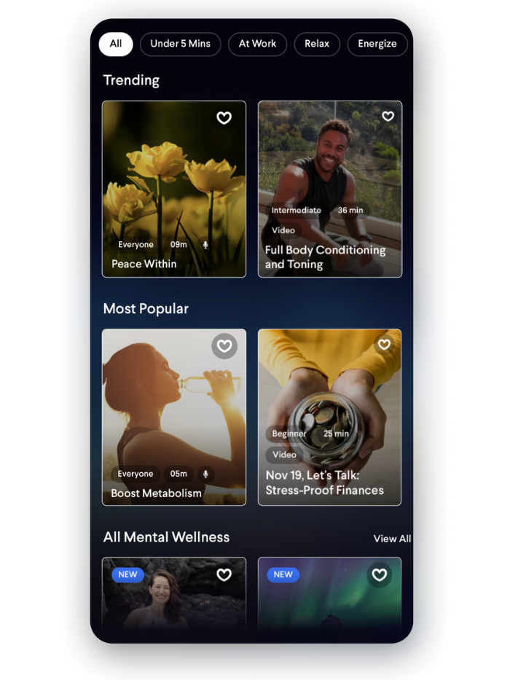
Your All-in-One Wellness Platform
Included in your Employee Benefits
Insert company name / logo

Slide 2



Wellness focused on the core areas of:
Personal Growth
Sleep Quality
Career Growth
Work Life Balance
Finance
Meditations & Bedtime Stories for Kids
Mental Wellness
Meditations & Mindfulness
Stress & Anxiety Management
Brain Health
Relationships
Resilience
Physical Fitness
Cardio and Workouts
Yoga & Stretches
Personal Training
Metabolic Health
Nutrition & Healthy Meals
Body Positivity

Slide 3

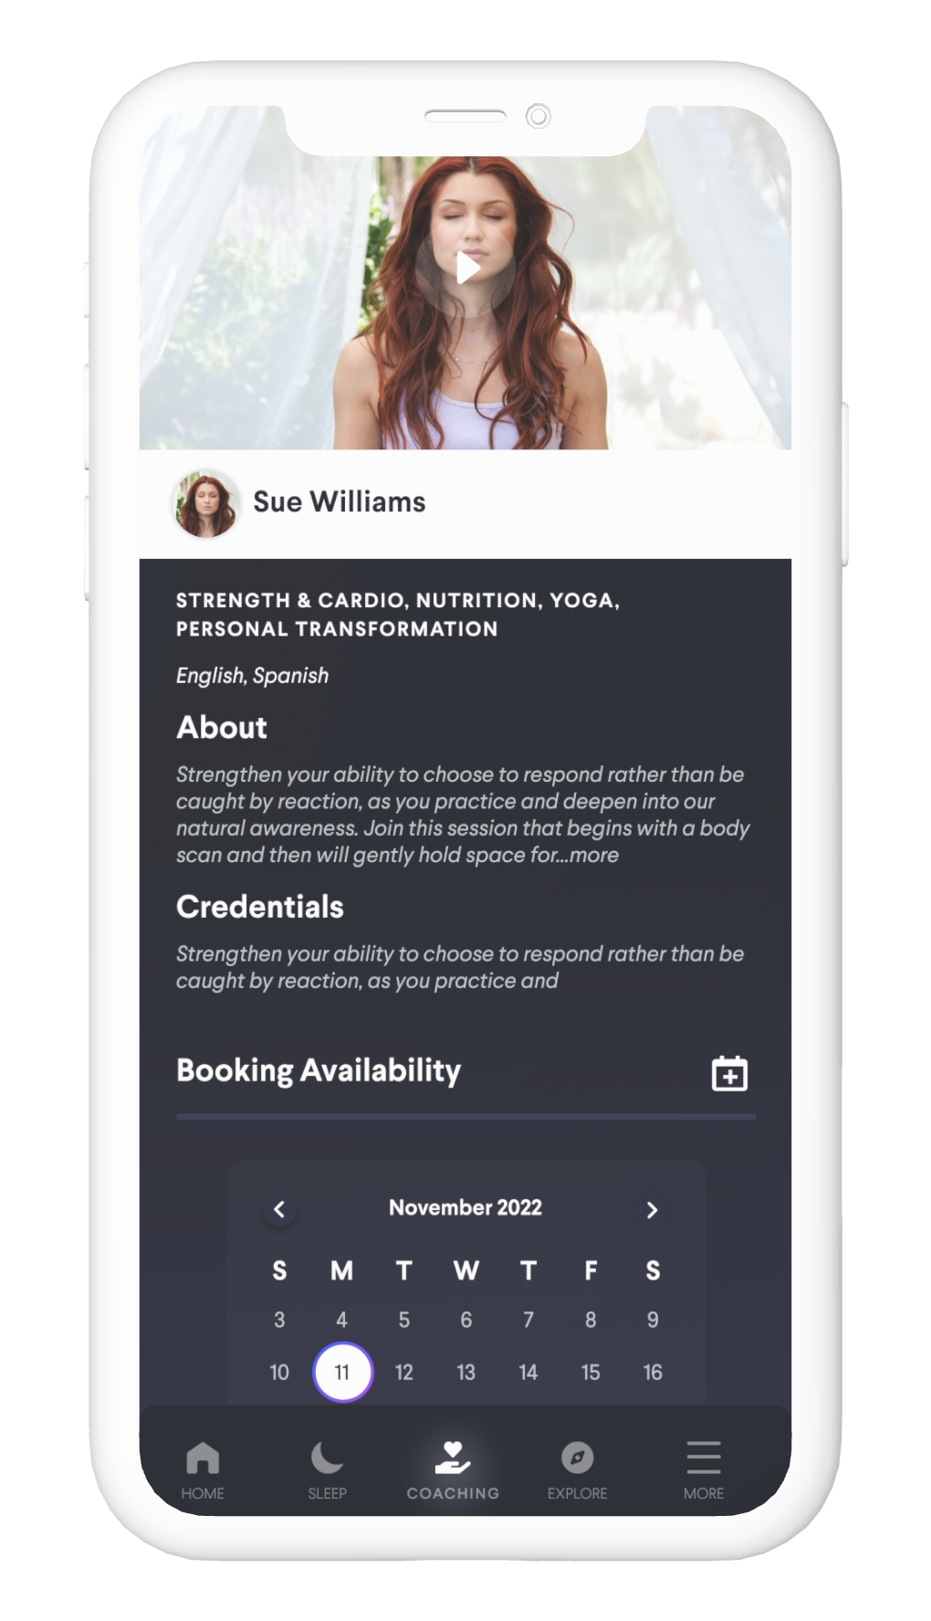
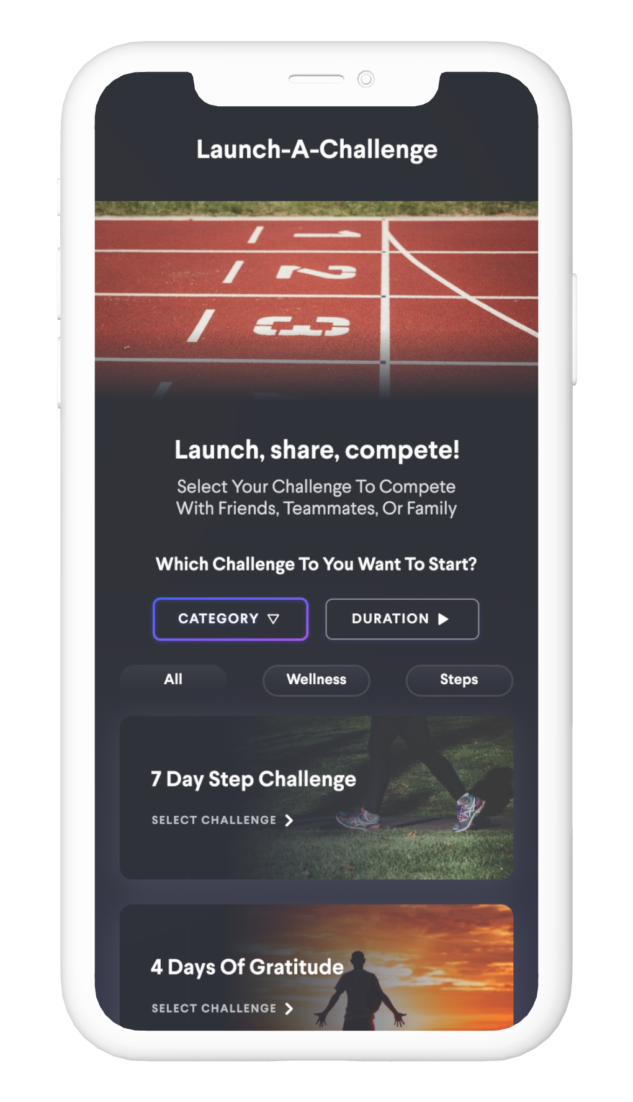
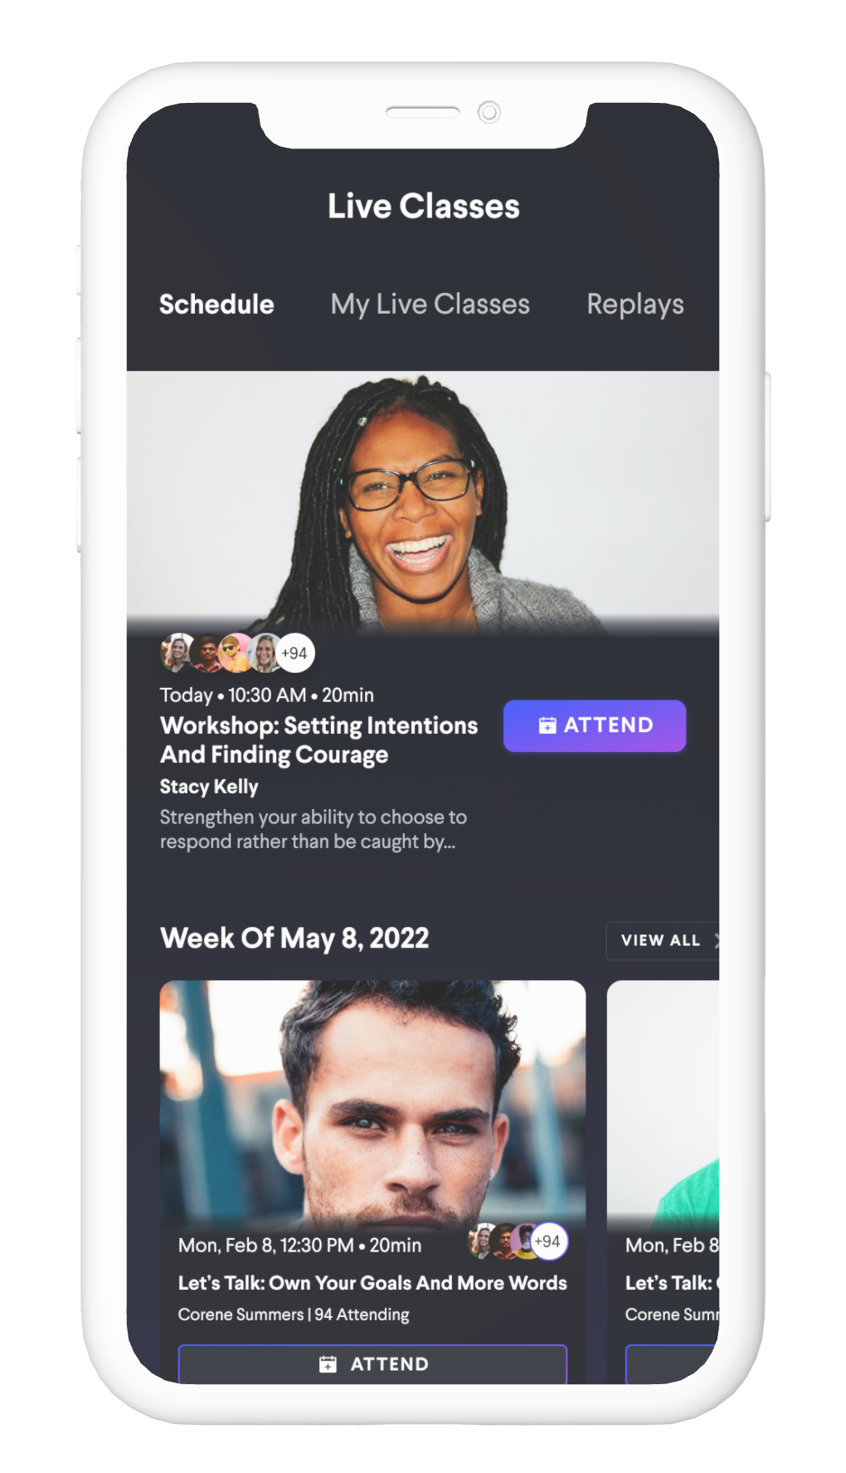
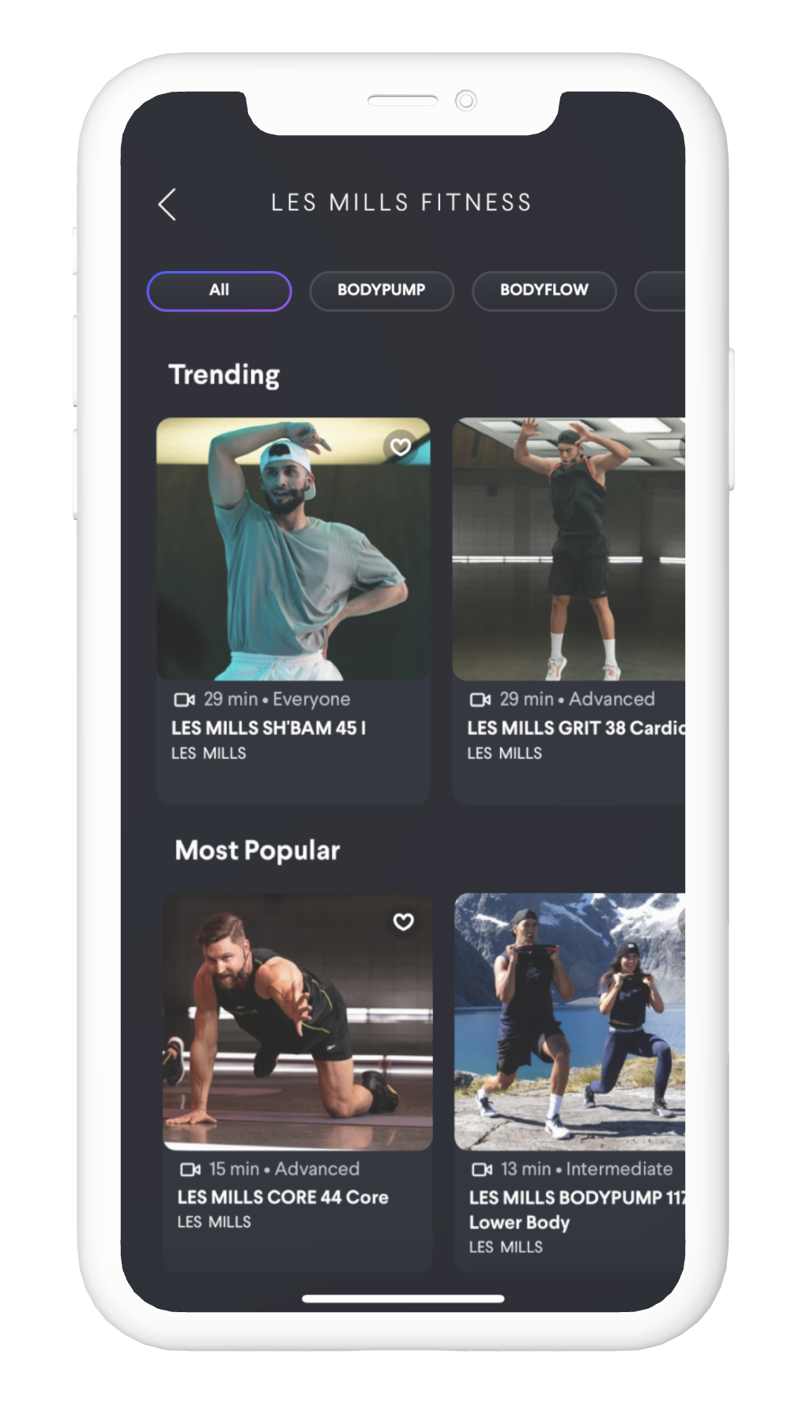





Supporting your Personal Well-Being
Personal Coaching
Wellness
Challenges
Live
Coaching
On-Demand Sessions
Plus more
100+ coaches worldwide & 15 wellness categories
Start Wellness & Walking Challenges with your friends!
20+ Classes to choose from every week
3,500+ classes, meditations, workshops, workouts, and music
Curated Programs
Goal Tracking for Water & Steps
Best-selling Audio Books
Share with 5 of your Family & Friends!
Access on your Workspace

Slide 4
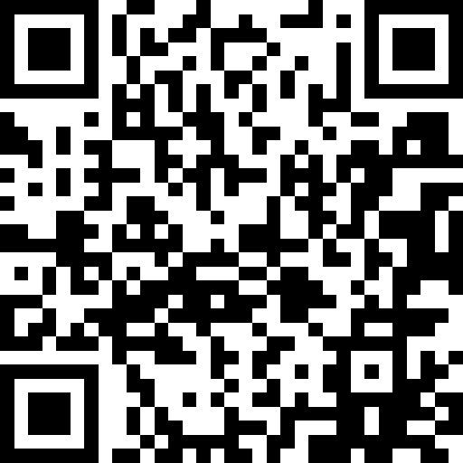

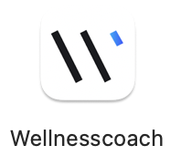


Get Started in 2 Minutes!
Click on the QR Code to open the desktop Wellness Coach App
Scan the QR code to download the Wellness Coach App
Sign in with your work email address
Verify your email with the 4-digit code (no password!)
Allow Notifications and Health Permissions to participate in Challenges!
1
2
3
4

